Slide 1
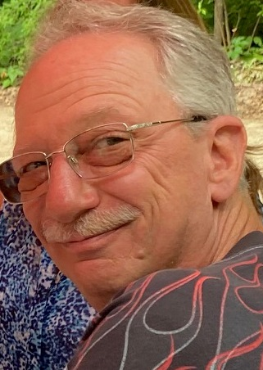
Jerry Pintar
1958 – 2023
A Celebration of Life
Family, club members, racers
Saturday, October 21, 5-8 pm
Oakland County Sportsman Club
4770 Waterford Road
Clarkston, MI 48346
Join us in the bar, no meal planned, you can order off the menu if desired. Casual, meet his family, bring stories, share with his friends and bring Jerry’s enthusiasm for life!

